Slide 1

2023-24 1-3 Single species models, stability, metapopulations Metapopulations
Vincent Jansen
vincent.jansen@rhul.ac.uk

Slide 2
Outline
1-1 Exponential Growth
1-2 Logistic growth, stability
1-3 Metapopulations

Slide 3
Logistic growth
The logistic growth model has a growth rate and carrying capacity as parameters.
But what do the parameters really mean?
The carrying capacity is often interpreted as a parameter of the system with a biological meaning
Often the carrying capacity depends on life history parameters
The get meaningful insights from the model you need to know how the biology feeds into the model

Slide 4
Metapopulations
The idea of a population of populations goes back to Andrewartha and Birch (1954) and Nicholson and Bailey (1934)
Richard Levins coined the term in 1969
The idea is related to McArthur and Wilson’s island biogeography

Slide 5
The Metapopulation Concept
Metapopulation:
A population of populations
Small populations are prone to become extinct
This can be due to external factors
Or through chance fluctuations (demographic stochasticity)
Regional persistence despite local extinction

Slide 6
Metapopulation Theory
Major assumption of metapopulation theory:
Local population dynamics are fast compared to the lifetime of a local population
The local densities reach equilibrium quickly after colonisation
All patches are the same

Slide 8
Metapopulation Theory
The number of occupied patches, rather than the number of individuals is the variable of interest
it is sufficient to know how many patches are occupied
p = fraction of patches occupied

Slide 9
Metapopulation Theory
Every patch has a similar rate of sending out dispersers (m p), which need to find empty patches (1-p). Colonisation rate m p (1-p)
Extinction rate, e, nr of extinctions: ep
Levins’ metapopulation model

Slide 10
Metapopulation Theory
Solution to the Levins’ model

Slide 11
Metapopulation Theory
This is the same as the logistic growth model
with

Slide 12
Metapopulation Theory
At the stable equilibrium p=1-e/m
Equilibrium p

Slide 13
Metapopulation Theory
Two observations:
For the metapopulation to persist colonisation needs to exceed extinction
There will always be unoccupied patches
The carrying capacity depends on the colonisation and extinction rates

Slide 14
Habitat destruction
Habitat destruction can easily be incorporated in metapopulation theory by assuming a fraction D cannot be colonised

Slide 15
Habitat destruction
Equilibrium fraction (1-D-e/m) decreases with habitat destruction:
D=
0
0.1
0.2
0.3
0.4
0.5

Slide 16
Suppose that at equilibrium, the spotted brown owl population occupies only 30% of an area, but all of the area is wooded and, in principle, suitable habitat. What would happen if the timber industry would be allowed to clear 40% of the woods?
It would not affect the population
Population would reduce by 40%
Population would now occupy 18%
Population will go extinct

Slide 17
Metapopulations
Note that in this respect the metapopulation model behaves fundamentally different from other models
Normally, reducing the area, say halfing it, halves the population size
In a metapopulation taking 60% of the area will have the effect of subtracting 60% from the equilibrium population size, and this could actually cause extinction

Slide 18
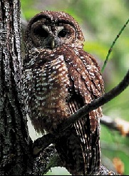
The Spotted Owl Debate
the metapopulation was used in the debate around the protection of the northern spotted owl (Strix occidentalis caurina) in the USA

Slide 19
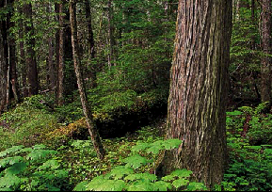
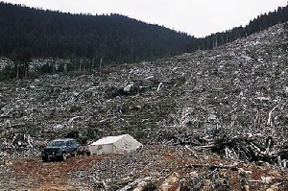
The Spotted Owl Debate
The northern spotted brown owl lives in old woodland in the north western USA (California, Oregon) and Canada
Increased logging of old forest is threatening the northern spotted owl

Slide 20
The Spotted Owl Debate
Logging is important for the local economy
By 1950 only 10-15% of the original old forest was left and the remaining forests were publicly owned
Logging continued leading to habitat loss and habitat fragmentation

Slide 21
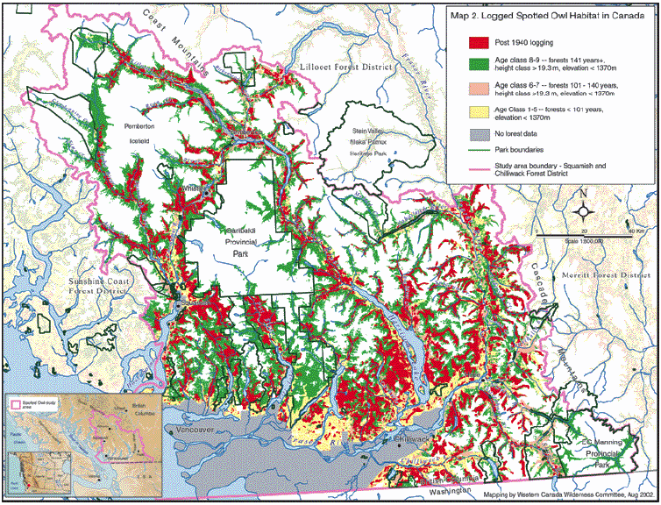
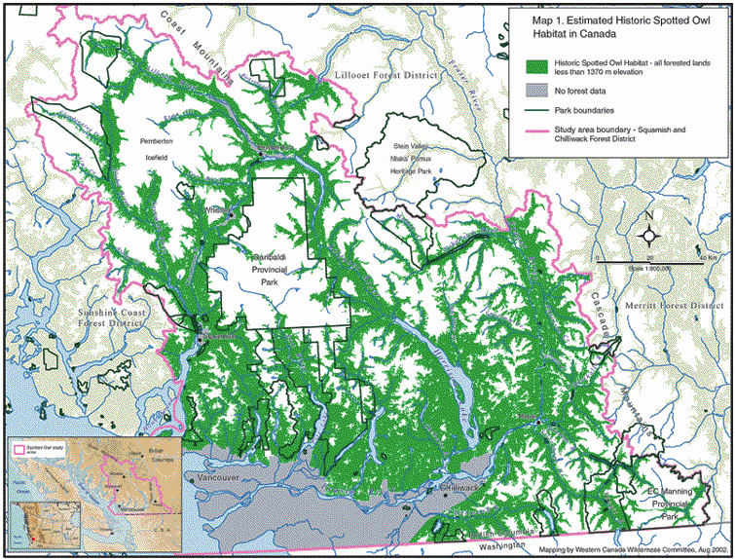

Slide 22
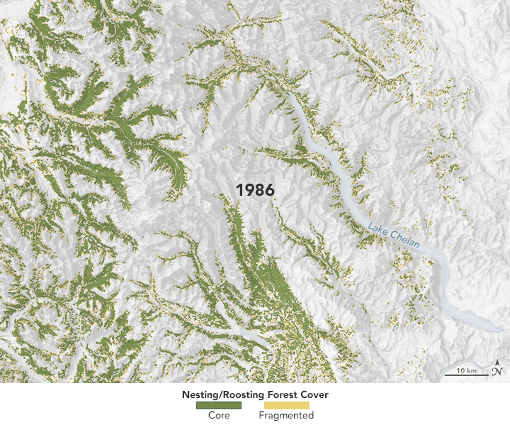
The decrease in spotted owl habitat in Eastern Washington 1996-2017
Notes:
The first map above shows forest disturbances detected each year between 1986 and 2017 across some of the owl’s range in eastern Washington. Disturbances from timber harvesting are shown in gold; fires and their scars are red; and tree mortality from insects and disease are blue. Purple areas represent everything else that can affect forest cover, from storms to drought.
The animation shows how such disturbances have affected the forests that spotted owls consider suitable for nesting or resting (roosting).
from
https://earthobservatory.nasa.gov/images/146038/spotting-the-spotted-owl-30-years-of-forest-disturbance

Slide 23
The Spotted Owl Debate
The northern spotted owl was listed as threatened in Oregon under the “Endangered Species Act”
This legally obliged the state to provide protection for this species, and its habitat
It caused a conflict environmental groups and timber industry

Slide 24
The Spotted Owl Debate
The spotted owl is an indicator species: a decline indicates that other species are possibly declining too
To breed and reproduce it needs large territories (400-3200 ha) of old forest (>150 yrs)

Slide 25
The Spotted Owl Debate
Young owls disperse and need to find new territories
Not all territories are occupied at all times
Territories fall empty and are reoccupied

Slide 26
The Spotted Owl Debate
This was an important element of the debate:
In order to protect the Spotted Owl, the Endangered Species Act states that the habitat has to be protected
Metapopulation models were used in court to make this case
Cutting down unoccupied territories can endanger the species, even if it doesn’t endanger individuals

Slide 27
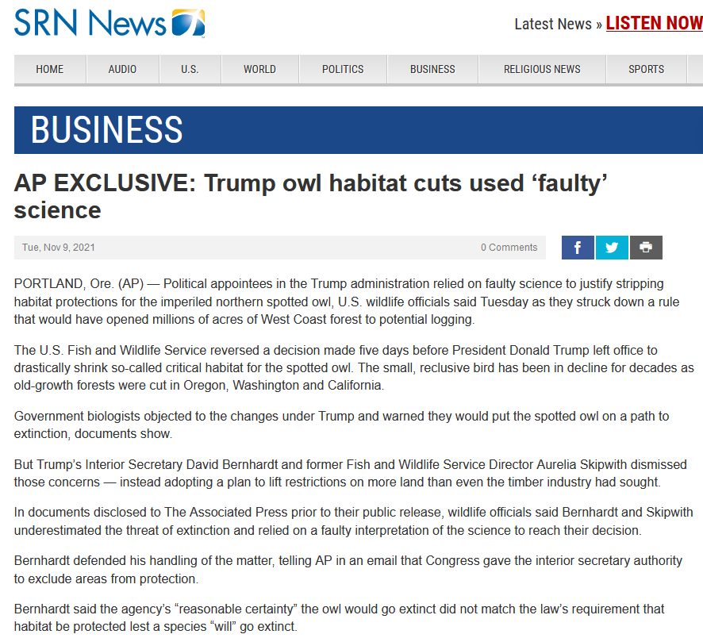
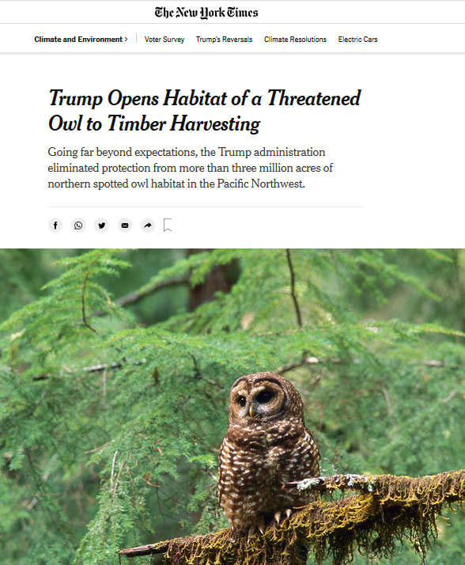
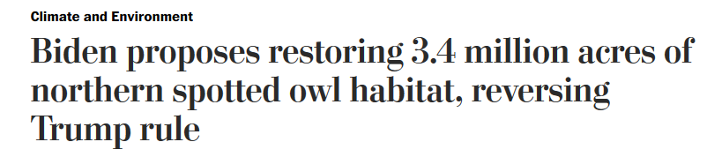
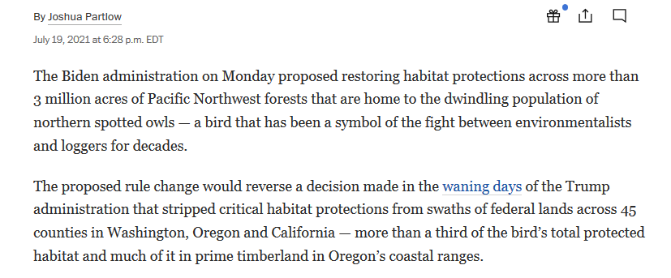
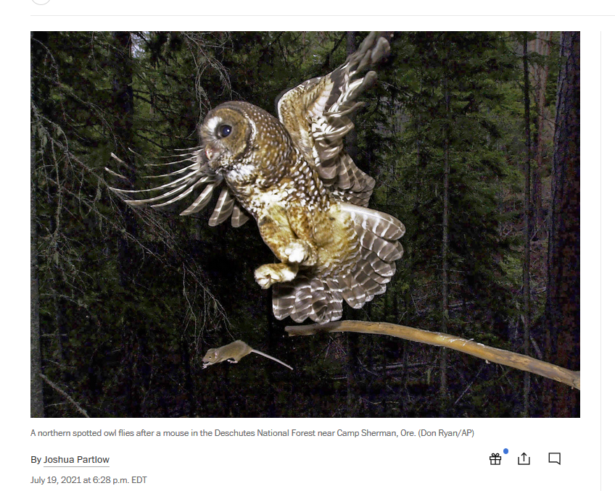
Jan 13, 2021

Slide 28
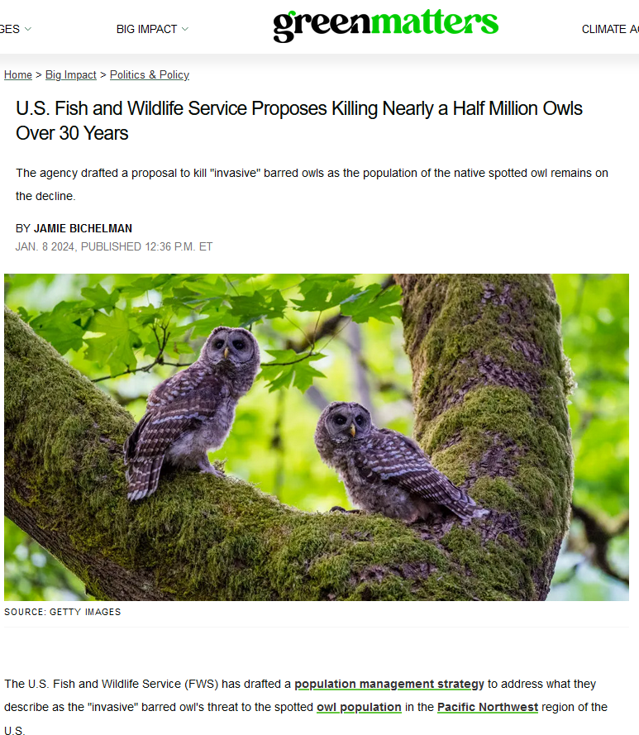
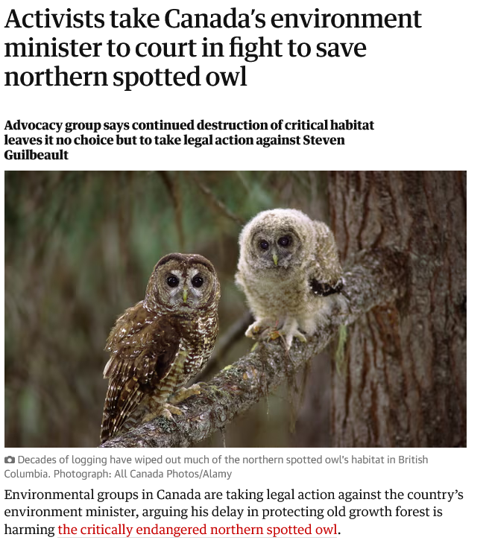
The Guardian 8/3/23

Slide 29
Examples of Metapopulations
Examples of metapopulations:
A number of butterfly populations have a metapopulation structure (Plebejus argus, Glanville fritillary, bay checkerspot)
Daphnia in rock pools
Voles on islands
Amphibians in ponds
(see Hanski’s books)

Slide 30
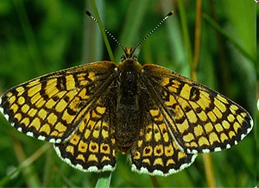
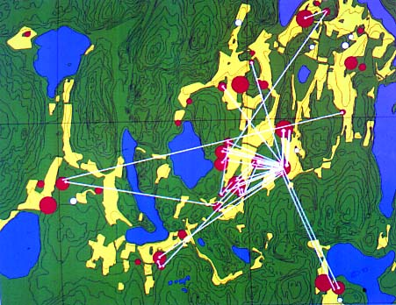
Examples of Metapopulations
Glanville fritillary (Melitaea cinxia)
Notes:
studied in the summer of 1991 on the Åland islands. A total of 1737 butterflies were marked, of which 741 were recaptured later. Most butterflies were recaptured on the same meadow, but 46 individuals migrated to a nearby patch.

Slide 31
Metapopulations and carrying capacity
What the metapopulation demonstrates is that the carrying capacity is not a simple parameter of the system
It depends on other factors, such as birth and death rates, or the ability to colonise space.
This has been generalised in other spatial models

Slide 32
Rescue effect
The Levins’ metapopulation assumes extinction rates are constant
colonisation
extinction
1-e/m

Slide 33
Rescue effect
The Levins’ metapopulation assumes extinction rates are constant
Population numbers in a patch depend on the number of patches occupied in the vicinity (immigration)
The extinction rate will decrease if more patches are occupied.
Hanski proposed e=e₀ exp(-ap)

Slide 34
Rescue effect
If e=e₀ exp(-ap)
extinction
colonisation

Slide 35
Rescue effect
The rescue effect can create alternative stable states, with the effect that the metapopulation becomes extinct if reduced below a threshold fraction

Slide 36
Work out the effect of the rescue effect for yourself in Practical 1.

Slide 37
Learning outcomes
Understand how the models can be derived from first principles.
Even though this might bring you back to well- known generic models (here, the logistic model in case of the metapopulation model) this detail allows you to gain insight and develop the model futher.

